Slide 1

DEPARTMENT OF PHYSICS
SRM INSTITUTE OF SCIENCE AND TECHNOLOGY
18PYB103J –Semiconduuctor Physics
Lecture 9 Problems
18PYB101J Module-IV Lecture-7

Slide 2
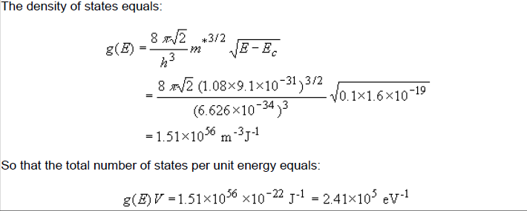
Problems: 1. Calculate the number of states per unit energy in a 100 by 100 by 10 nm piece of silicon (m* = 1.08 m₀) 100 meV above the conduction band edge. Write the result in units of eV⁻¹.
18PYB101J Module-IV Lecture-7

Slide 3
Thank you
18PYB101J Module-IV Lecture-8

